Slide 1
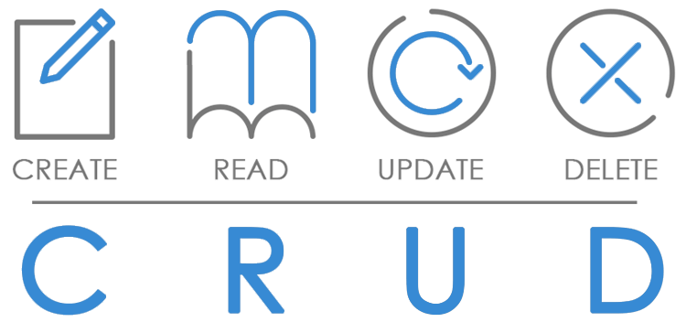
Common Model
Framework
Perform operations on data in backend
Add headers and customize request-URL
Format data for JET collection components
Standard methods to apply to data (get, filter, metadata, transform)
Notes:
Methods to apply: get a specific record, filter the data, get indexnumbers and fetchsizes, transform data to JSON

Slide 2
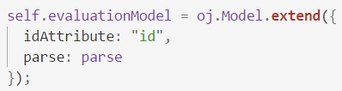
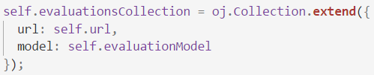
Common Model
Model
Collection
Tabel
Record
Record
Record
Record

Slide 3
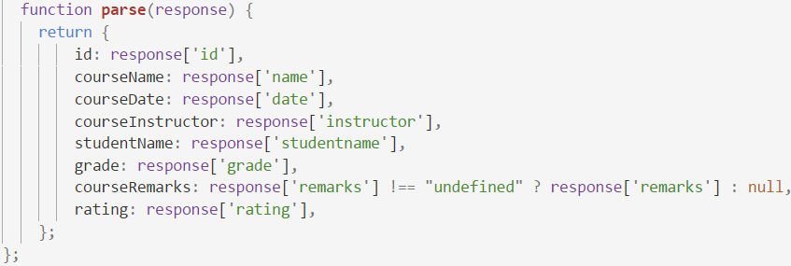
Common Model
REST
GET
JSON
Parse to easy to use object

Slide 4
Common Model
Datasource
Representation of data usable by components
CollectionTableDataSource can be used by Table
Notes:
Can depend on representation of data (collection or array) and the jet component

